Slide 1
Machine Learning CSE - 403 Lecture - 05

Slide 2
Candidate Elimination Algorithm
The candidate elimination algorithm incrementally builds the version space given a hypothesis space H and a set E of examples.
The examples are added one by one; each example possibly shrinks the version space by removing the hypotheses that are inconsistent with the example.
The candidate elimination algorithm does this by updating the general and specific boundary for each new example.

Slide 3
Candidate Elimination Algorithm
You can consider this as an extended form of Find-S algorithm.
Consider both positive and negative examples.
Actually, positive examples are used here as Find-S algorithm (Basically they are generalizing from the specification).
While the negative example is specified from generalize form.

Slide 4
Candidate Elimination Algorithm
Step1: Load Data set
Step2: Initialize General Hypothesis and Specific Hypothesis.
Step3: For each training example
Step4: If example is positive example
if attribute_value == hypothesis_value:
Do nothing
else:
replace attribute value with '?' (Basically generalizing it)
Step5: If example is Negative example
Make generalize hypothesis more specific.

Slide 5
Candidate Elimination Algorithm
Concept learning: Concept learning is basically learning task of the machine (Learn by Train data)
General Hypothesis: Not Specifying features to learn the machine.
G = {‘?’, ‘?’,’?’,’?’…}: Number of attributes
Specific Hypothesis: Specifying features to learn machine (Specific feature)
S= {‘pi’,’pi’,’pi’…}: Number of pi depends on number of attributes.
Version Space: It is intermediate of general hypothesis and Specific hypothesis. It not only just written one hypothesis but a set of all possible hypothesis based on training data-set.

Slide 6
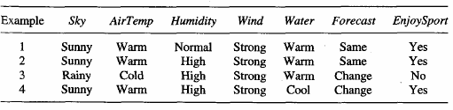
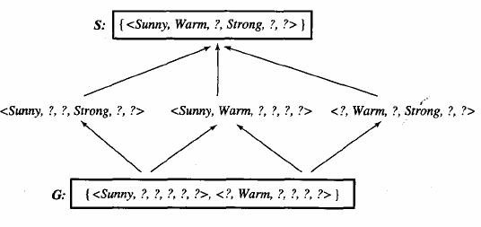
Least General (Most Specific)
Most General
(Least Specific)

Slide 7
Example
G0 ← {<?, ?, ?, ?, ?, ?>}
Initialization
S0 ← {<Ø, Ø, Ø, Ø, Ø, Ø >}

Slide 8
G0 ← {<?, ?, ?, ?, ?, ?>}
S0 ← {<Ø, Ø, Ø, Ø, Ø, Ø >}
x1 = <Sunny, Warm, Normal, Strong, Warm, Same>
Iteration 1
G1 ← {<?, ?, ?, ?, ?, ?>}
S1 ← {< Sunny, Warm, Normal, Strong, Warm, Same >}
x2 = <Sunny, Warm, High, Strong, Warm, Same>
Iteration 2
G2 ← {<?, ?, ?, ?, ?, ?>}
S2 ← {< Sunny, Warm, ?, Strong, Warm, Same >}

Slide 9
G2 ← {<?, ?, ?, ?, ?, ?>}
S2 ← {< Sunny, Warm, ?, Strong, Warm, Same >}
consistent
x3 = <Rainy, Cold, High, Strong, Warm, Change>
Iteration 3
S3 ← {< Sunny, Warm, ?, Strong, Warm, Same >}
G3 ← {<Sunny, ?, ?, ?, ?, ?>, <?, Warm, ?, ?, ?, ?>, <?, ?, ?, ?, Same>}
G2 ← {<?, ?, ?, ?, ?, ?>}

Slide 10
S3 ← {< Sunny, Warm, ?, Strong, Warm, Same >}
G3 ← {<Sunny, ?, ?, ?, ?, ?>, <?, Warm, ?, ?, ?, ?>, <?, ?, ?, ?, Same>}
x4 = <Sunny, Warm, high, Strong, Cool, Change>
Iteration 4
S4 ← {< Sunny, Warm, ?, Strong, ?, ? >}
G4 ← {<Sunny, ?, ?, ?, ?, ?>, <?, Warm, ?, ?, ?, ?>}
G3 ← {<Sunny, ?, ?, ?, ?, ?>, <?, Warm, ?, ?, ?, ?>, <?, ?, ?, ?, Same>}

Slide 11
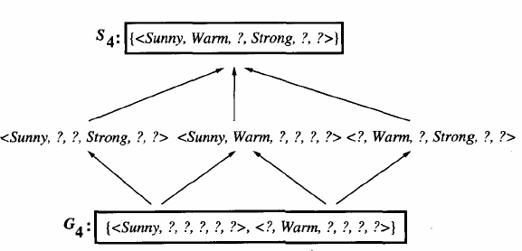

Slide 13
Remarks on Version Spaces and Candidate-Elimination
The version space learned by the CANDIDATE-ELIMINATION algorithm will converge toward the hypothesis that correctly describes the target concept, provided
there are no errors in the training examples, and
there is some hypothesis in H that correctly describes the target concept.

Slide 14
What will Happen if the Training Contains errors ?
No

Slide 15
G0 ← {<?, ?, ?, ?, ?, ?>}
S0 ← {<Ø, Ø, Ø, Ø, Ø, Ø >}
No
x1 = <Sunny, Warm, Normal, Strong, Warm, Same>
Iteration 1
G1 ← {<?, ?, ?, ?, ?, ?>}
S1 ← {< Sunny, Warm, Normal, Strong, Warm, Same >}
x2 = <Sunny, Warm, High, Strong, Warm, Same>
Iteration 2
G2 ← {<?, ?, Normal, ?, ?, ?>}
S2 ← {< Sunny, Warm, Normal, Strong, Warm, Same >}

Slide 16
G2 ← {<?, ?, Normal, ?, ?, ?>}
S2 ← {< Sunny, Warm, Normal, Strong, Warm, Same >}
No
consistent
x3 = <Rainy, Cold, High, Strong, Warm, Change>
Iteration 3
S3 ← {< Sunny, Warm, Normal, Strong, Warm, Same >}
G3 ← {<?, ?, Normal, ?, ?, ?>}
G3 ← {<Sunny,?,?,?,?,?> <?, Warm,?,?,?,?> <?, ?, Normal, ?, ?, ?> <?,?,?,?,?, Same>}

Slide 17
S3 ← {< Sunny, Warm, Normal, Strong, Warm, Same >}
No
G3 ← {<?, ?, Normal, ?, ?, ?>}
S4 ← {< Sunny, Warm, ?, Strong, ?, ? >}
x4 = <Sunny, Warm, high, Strong, Cool, Change>
Iteration 4
S4 ← { }
Empty
G4 ← { }
G4 ← {<?, ?, Normal, ?, ?, ?>}

Slide 18
Remarks on Version Spaces and Candidate-Elimination
The target concept is exactly learned when the S and G boundary sets converge to a single, identical, hypothesis.

Slide 19
Remarks on Version Spaces and Candidate-Elimination
How Can Partially Learned Concepts Be Used?
Suppose that no additional training examples are available beyond the four in our example. And the learner is now required to classify new instances that it has not yet observed.
The target concept is exactly learned when the S and G boundary sets converge to a single, identical, hypothesis.

Slide 20
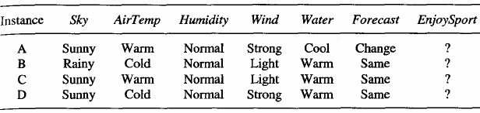
Remarks on Version Spaces and Candidate-Elimination

Slide 21
Remarks on Version Spaces and Candidate-Elimination
All six hypotheses satisfied
All six hypotheses dissatisfied

Slide 22
Remarks on Version Spaces and Candidate-Elimination
Three hypotheses satisfied
Three hypotheses not satisfied
Two hypotheses satisfied
Four hypotheses not satisfied

Slide 23
Thank You

